Slide 1
Welcome to our presentation
Our Presenter :
1.Rubayet Ahmed
2.Pronob Kumar Roy
3.Salman Ahmed
4.Bina Debi

Slide 2
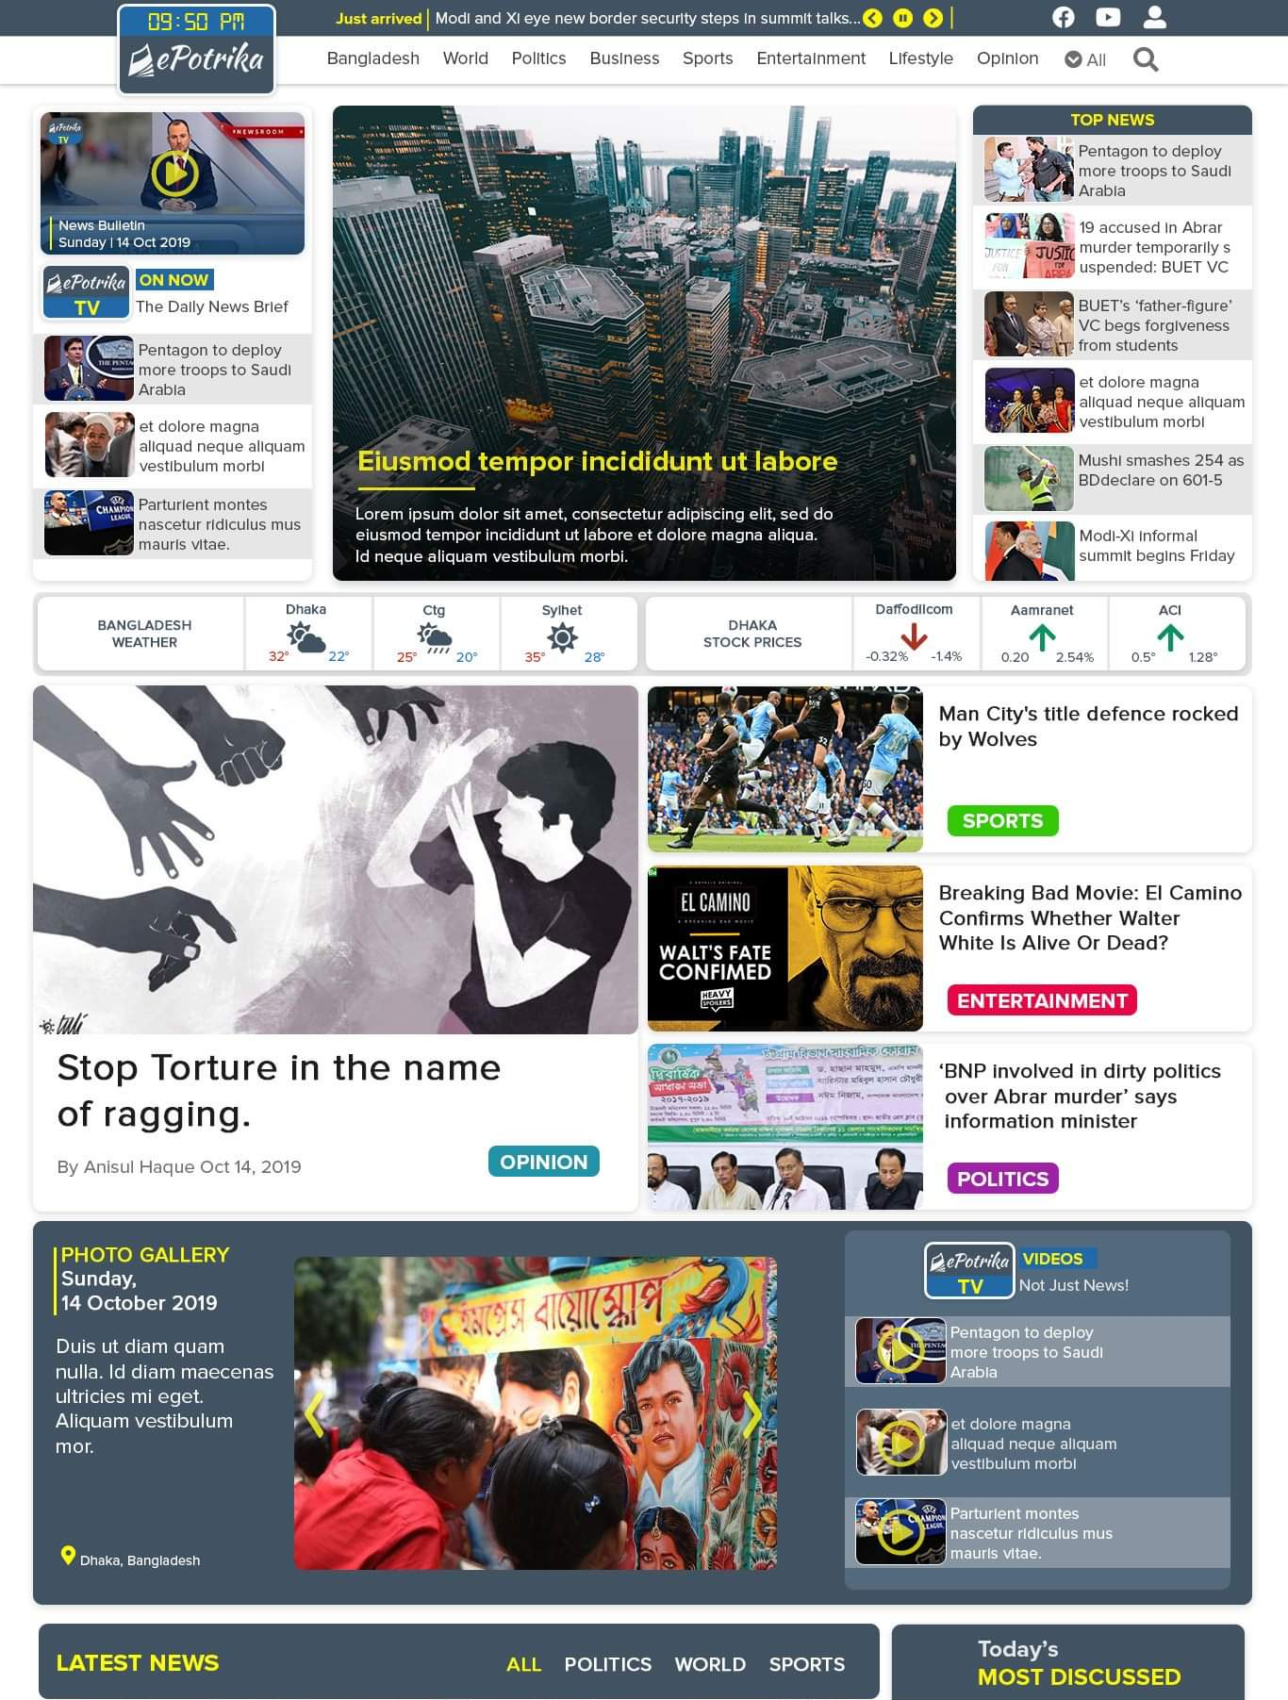
News Portal
News paper is not just a ‘paper ‘ anymore.
We focused on more media, less text method
Each section is divided into separate module.

Slide 3
Header
Top bar:
Top bar is used to show important just arrived news.
Menu: Header part includes links to other pages.

Slide 4
Video bulletin
News of the day
Top News

Slide 5
Photo gallery with caption
Important events are displayed here
Included video gallery for better experience

Slide 6
Weather update: shows weather status of major divisions
Stock update: shows top 20 share prices

Slide 7
Tabbed content
Weather update: shows weather status of major divisions
Stock update: shows top 2p share prices

Slide 8

Question aren’t welcome!

